Slide 1
Mask Processing

Slide 2
Fundamentals of Spatial Filters:
It is a basic tool for image enhancement.
Here Filter refers to accepting(passing)/rejecting certain frequency components.
The filter that passes lower frequencies is called a lowpass filter; is to blur (smooth) an image.
It is also called Mask/Filter/Kernel/window.
Mask is a type of filter which performs operation directly on the image.

Slide 3
There are two types:
Smoothing Spatial Filter(Lowpass)
1. Linear Spatial Filter(Mean)
2. Non-linear Spatial Filter (Median)
2. Sharpening Filter

Slide 4
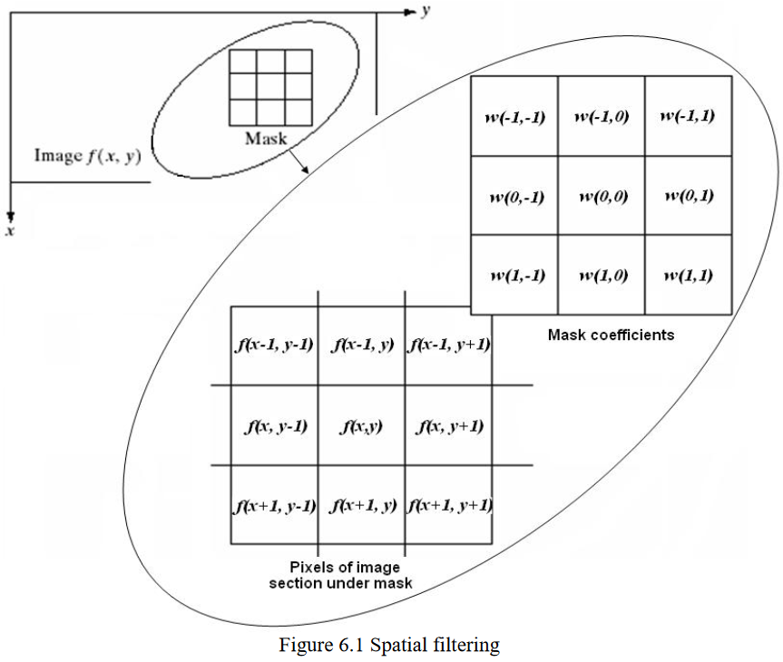
The size of mask must be odd (i.e. 3×3, 5×5, etc.) to ensure it has a center.
The smallest meaningful size is 3×3.

Slide 5
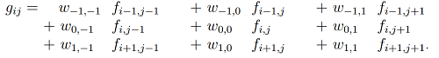
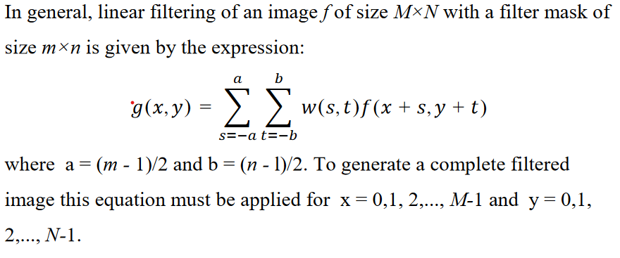
m=2a+1 n=2b+1

Slide 6
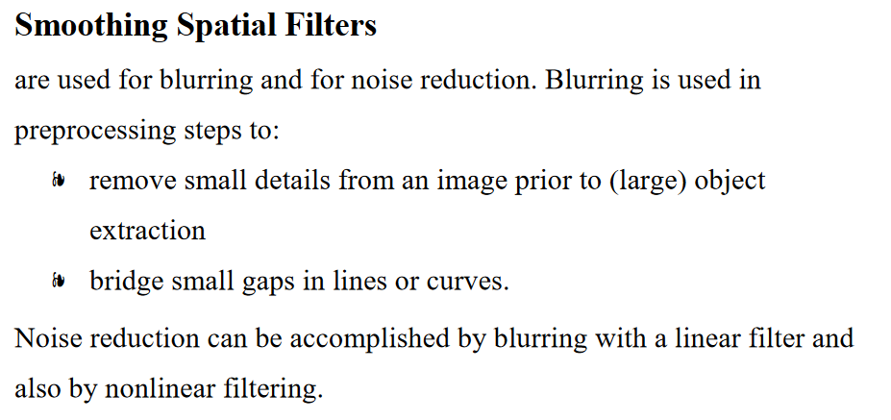
Smoothing Spatial Filters
By replacing the value of image pixel by average of intensity levels in neighborhood by filter mask.

Slide 7
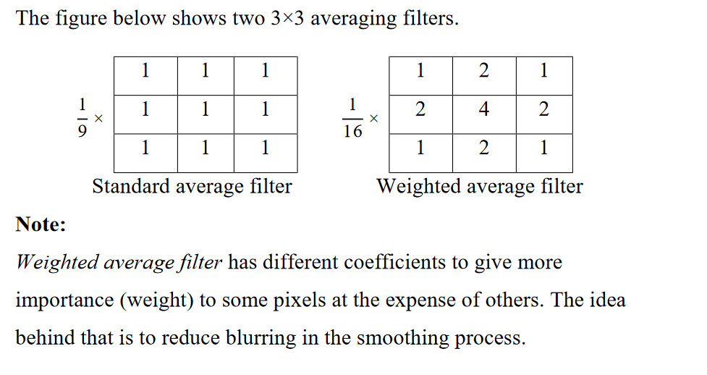
Averaging linear filters
The response of averaging filter is simply the average of the pixels contained in the neighborhood of the filter mask.
The output of averaging filters is a smoothed image with reduced "sharp" transitions in gray levels.
In which all coefficients are equal is called a Box filter.

Slide 8
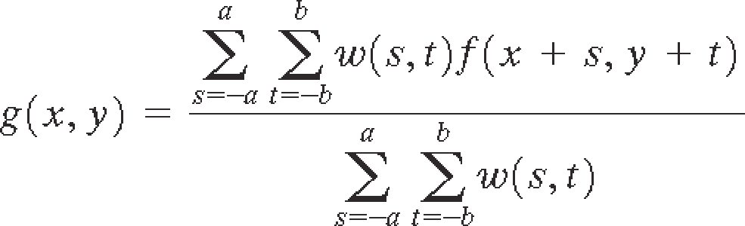
Weighted Averaging linear filtering of an image f of filter mask of size m×n (m,n are odd) is given by the expression:
To generate a complete filtered image this equation must be applied for x = 0,1, 2,..., M-1 and y = 0,1, 2,..., N-1.

Slide 9
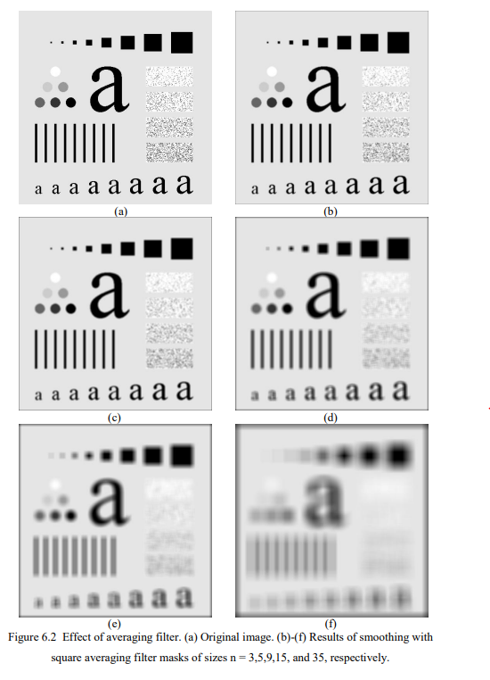

Slide 10
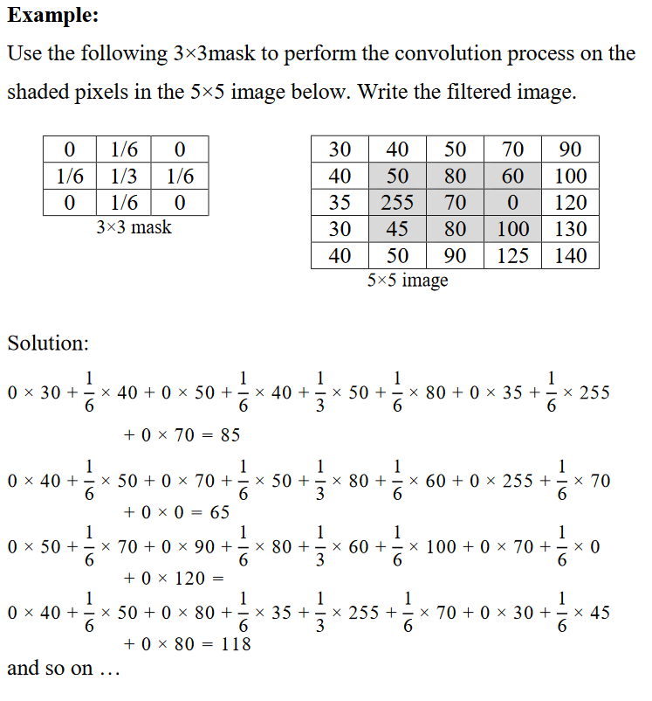

Slide 11
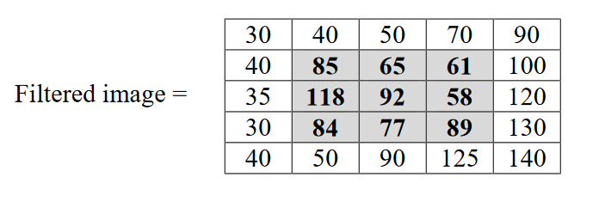
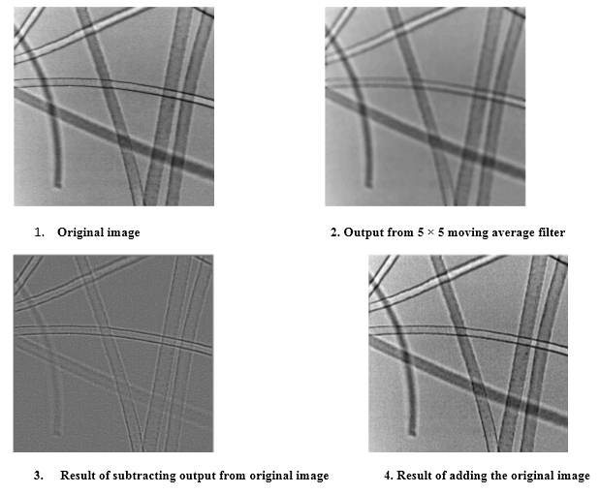

Slide 12
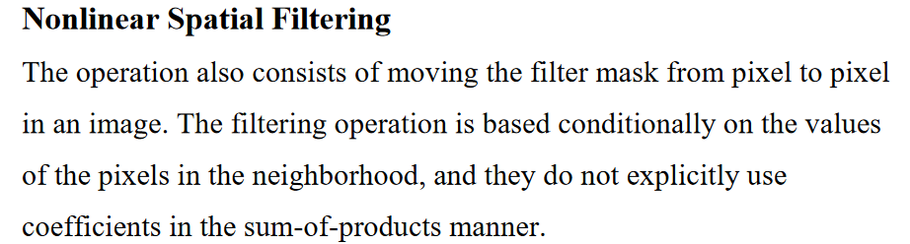

Slide 13
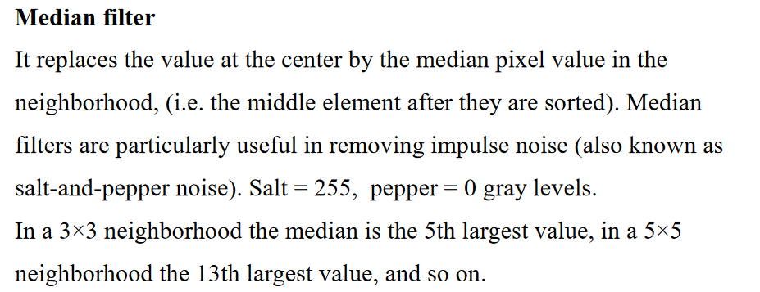
Types of Order statistics filter:
(i) Minimum filter: 0th percentile filter is the minimum filter. The value of the center is replaced by the smallest value in the window.
(ii) Maximum filter: 100th percentile filter is the maximum filter. The value of the center is replaced by the largest value in the window.
(iii) Median filter: Each pixel in the image is considered. First neighboring pixels are sorted and original values of the pixel is replaced by the median of the list

Slide 14
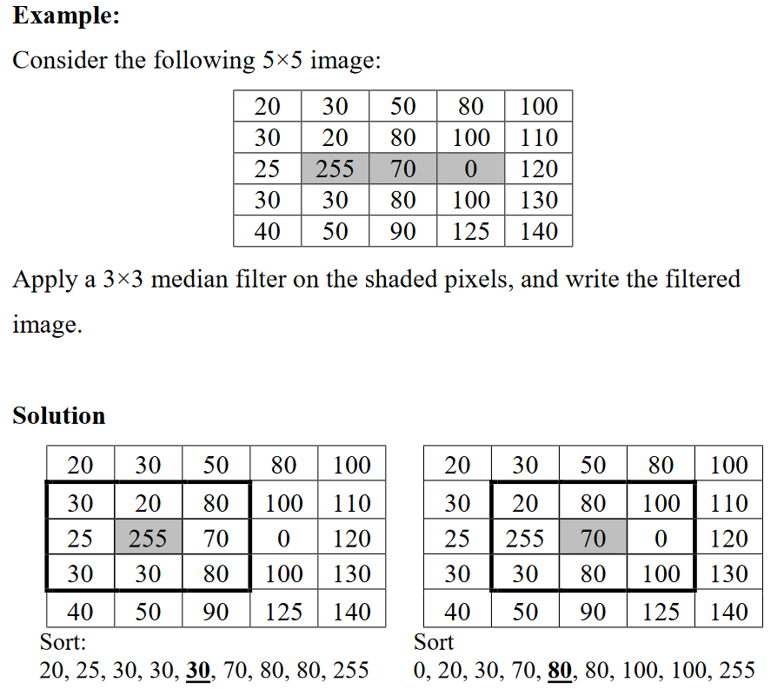

Slide 15
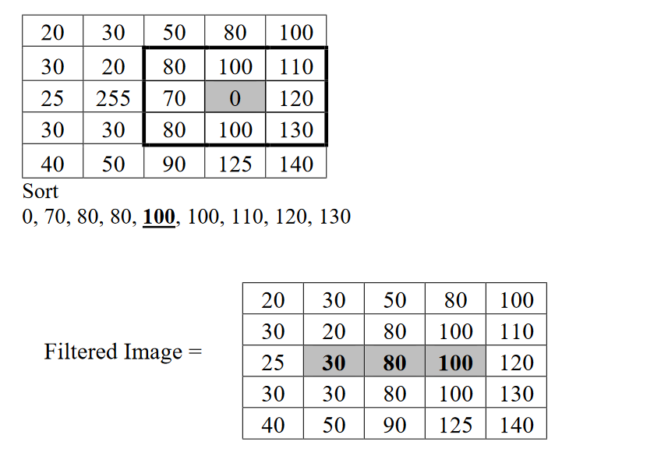

Slide 16
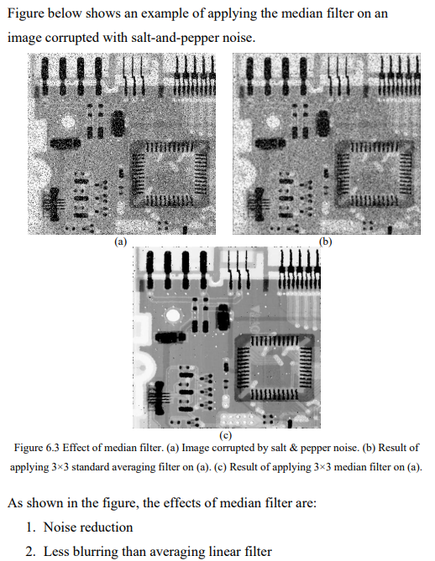

Slide 17
Sharpening Spatial Filters
Sharpening aims to highlight edges in an image or enhance detail that has been blurred through errors or imperfect capturing devices.
Image blurring can be achieved using averaging filters, and hence sharpening can be achieved by operators that invert averaging operators.
In mathematics, averaging is equivalent to the concept of integration, and differentiation inverts integration. Thus, sharpening spatial filters can be represented by partial derivatives.

Slide 18
Sharpening Spatial Filters Applications
Electric printing
Medical imaging
Industrial inspection
Autonomous guidance in military systems.

Slide 19
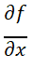
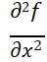
The derivatives of digital fn are defined interms of differences
First order derivative:
Must be zero in flat segments.
Must be non zero at the onset of a grey level step.
Must be non zero along ramps.
First order derivative in 1-D is given by:
= f(x+1) - f(x)
Second order derivative:
Must be zero in flat areas.
Must be zero at the onset and end of a ramp.
Must be zero along ramps.
Second order derivative in 1-D is given by:
= f(x+1) + f(x-1) - 2f(x)

Slide 20
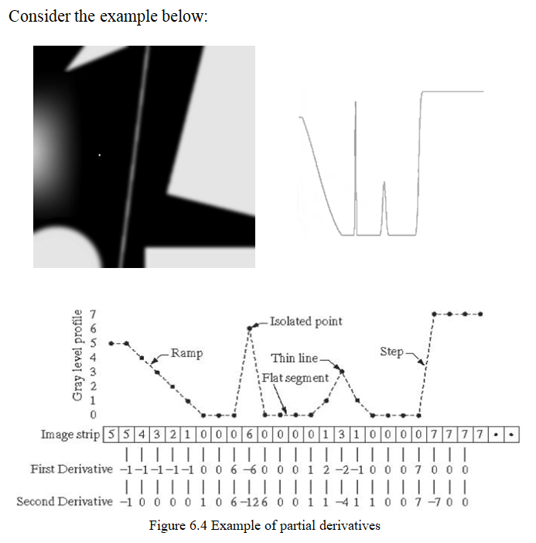

Slide 21
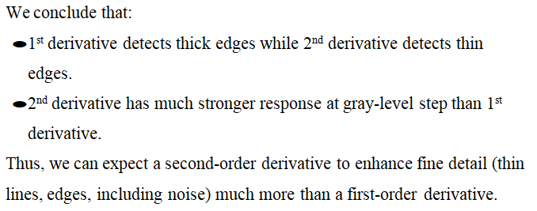

Slide 22
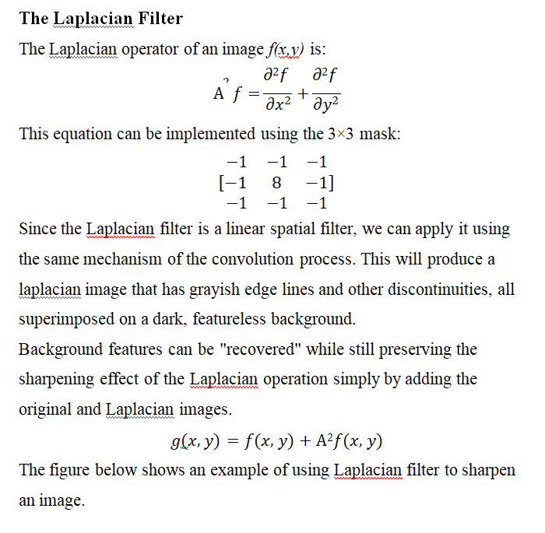

Slide 23
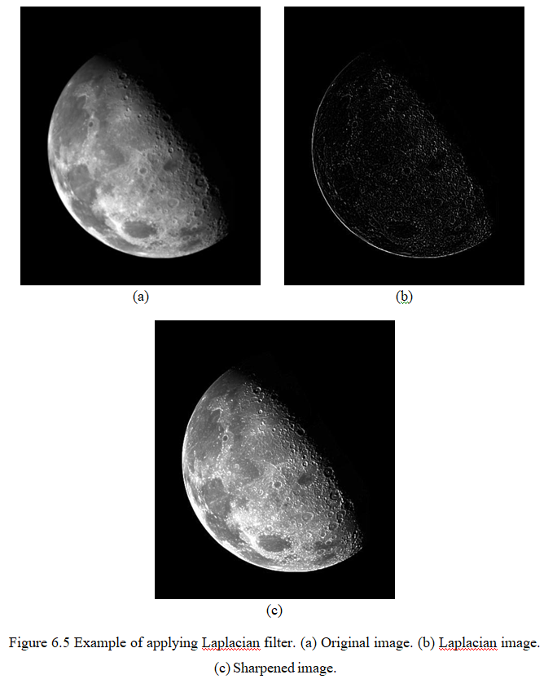

Slide 24
Frequency Domain Filters and its Types
Frequency Domain Filters are used for smoothing and sharpening of image by removal of high or low frequency components.
Sometimes it is possible of removal of very high and very low frequency.
Frequency domain filters are different from spatial domain filters as it basically focuses on the frequency of the images.
It is basically done for two basic operation i.e., Smoothing and Sharpening.

Slide 25
Frequency Domain Filters Fundamentals
Filtering in FrequencyDomain consists of-
Modifying the Fourier transform of an image
Computing the Inverse DFT to obtain the processed image.
Thus the digital image f(x,y) of size M×N
The Filtering image:
g(x,y)= F⁻¹ [H(u,v)F(u,v)]
F⁻¹ --> IDFT
F(u,v) -->DFT of input image f(x,y)
H(u,v)-->Filter function/ Filter transfer function
g(x,y) --> Filtered output image.
F, H, g are arrays of M×N

Slide 26
Fourier Transform:
The Fourier Transform is an important image processing tool which is used to decompose an image into its sine and cosine components.
The output of the transformation represents the image in the Fourier / frequency domain,
while the input image is the spatial domain equivalent.
In the Fourier domain image, each point represents a particular frequency contained in the spatial domain image.

Slide 27
IDFT:
The inverse discrete-time Fourier transform (IDTFT) is defined as the process of finding the discrete-time sequence x(n) from its frequency response X(ω).

Slide 28
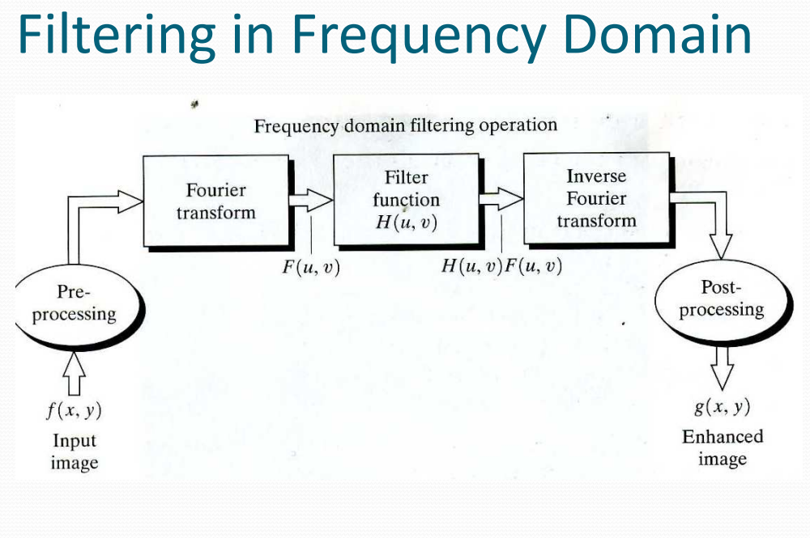

Slide 29
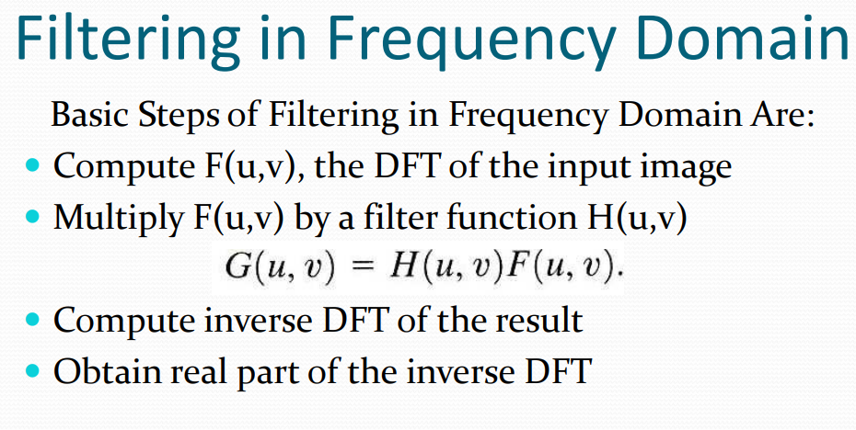

Slide 30
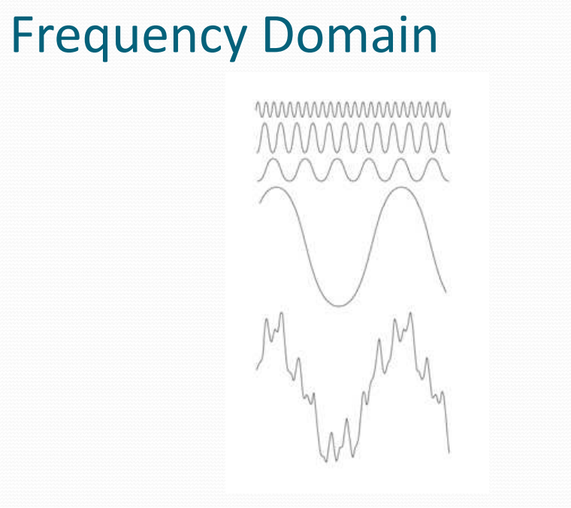

Slide 31
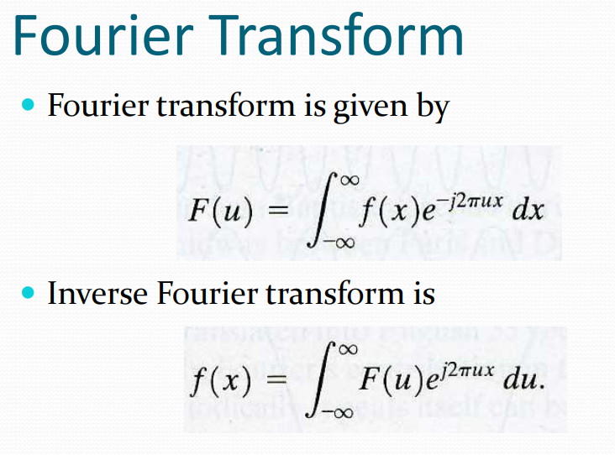

Slide 32
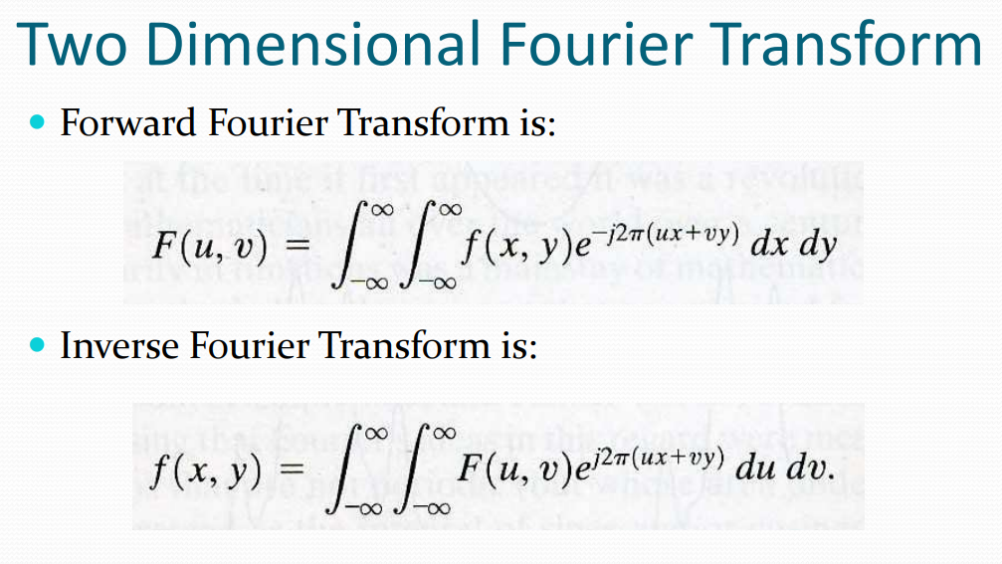

Slide 33
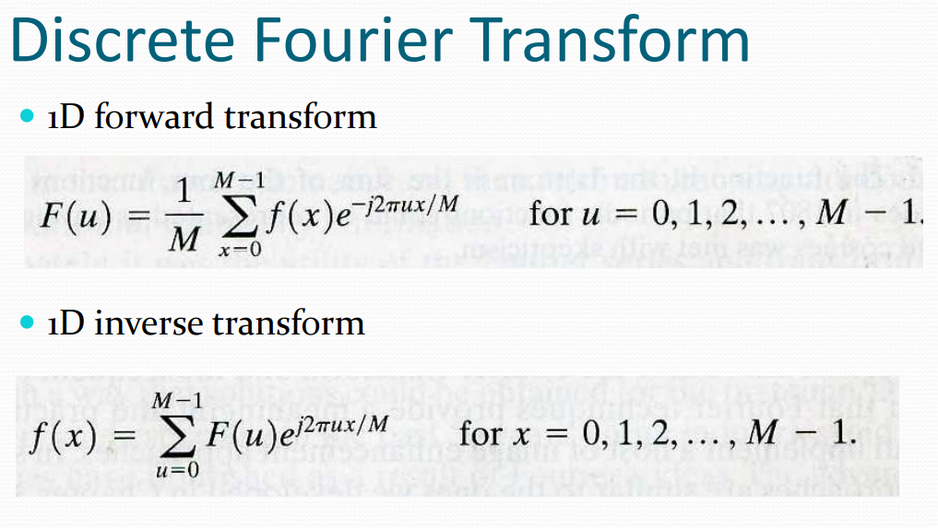

Slide 34
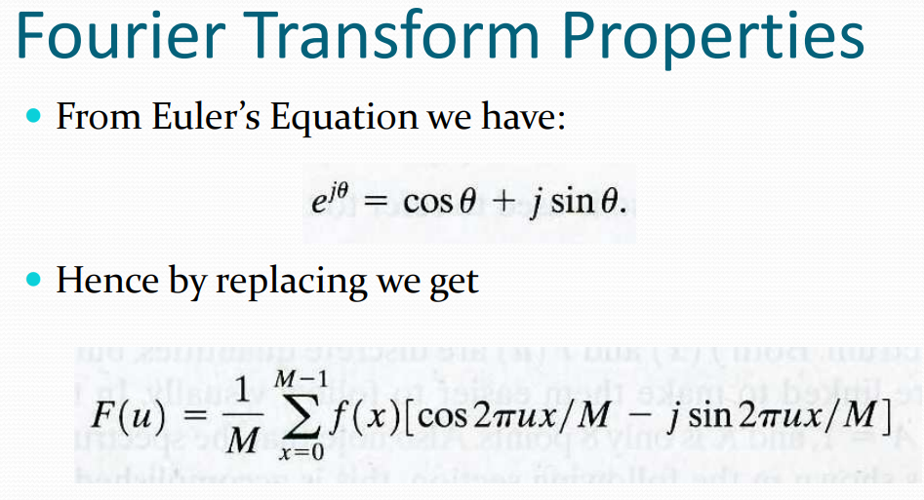

Slide 35
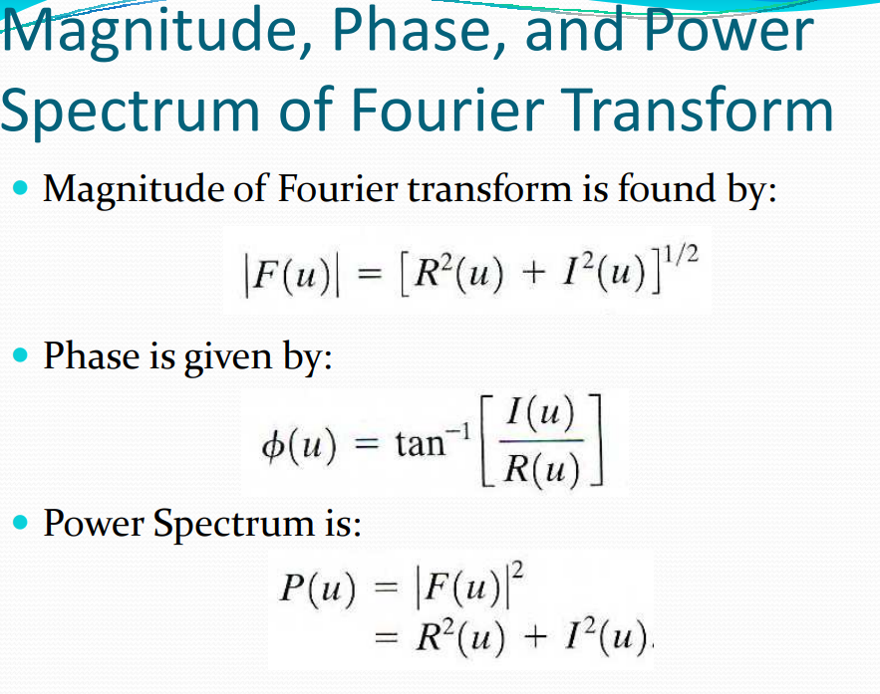

Slide 36
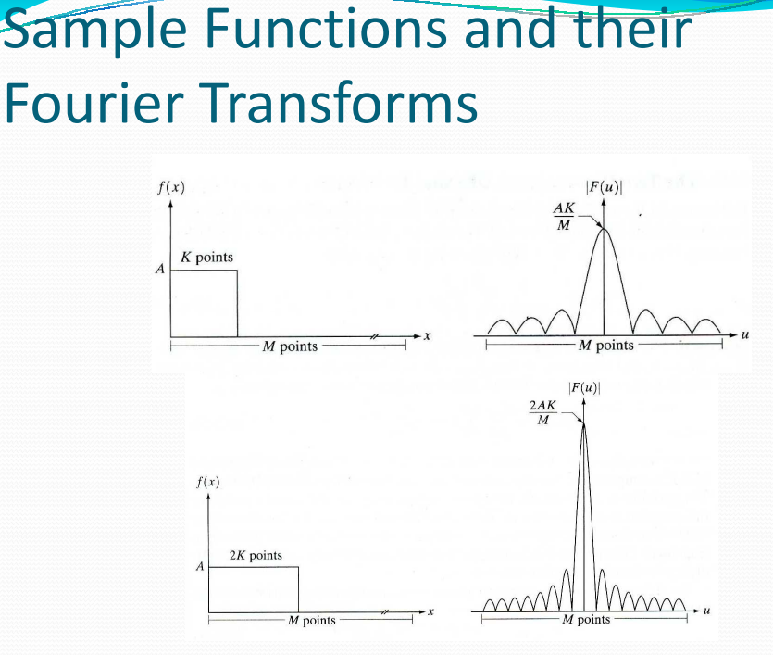

Slide 37
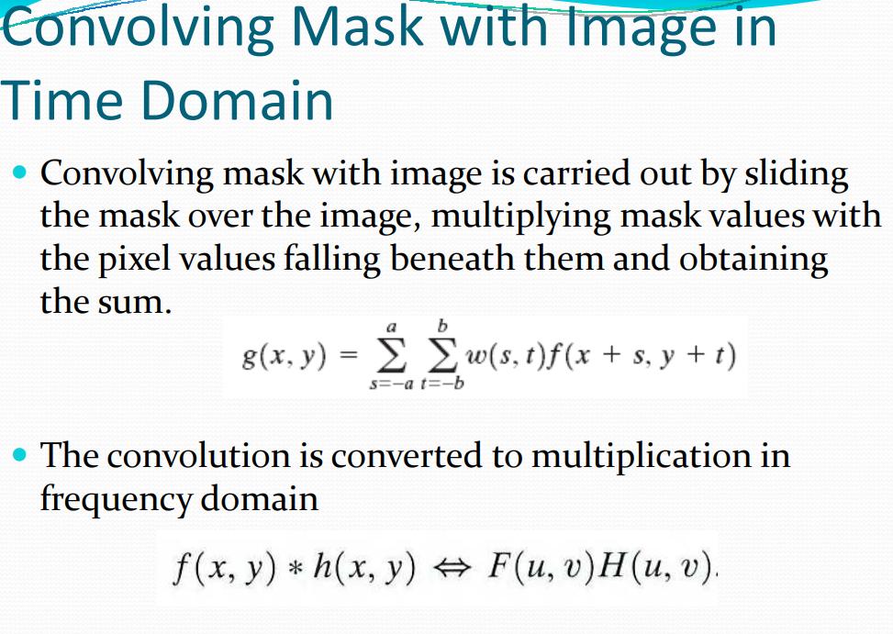

Slide 38
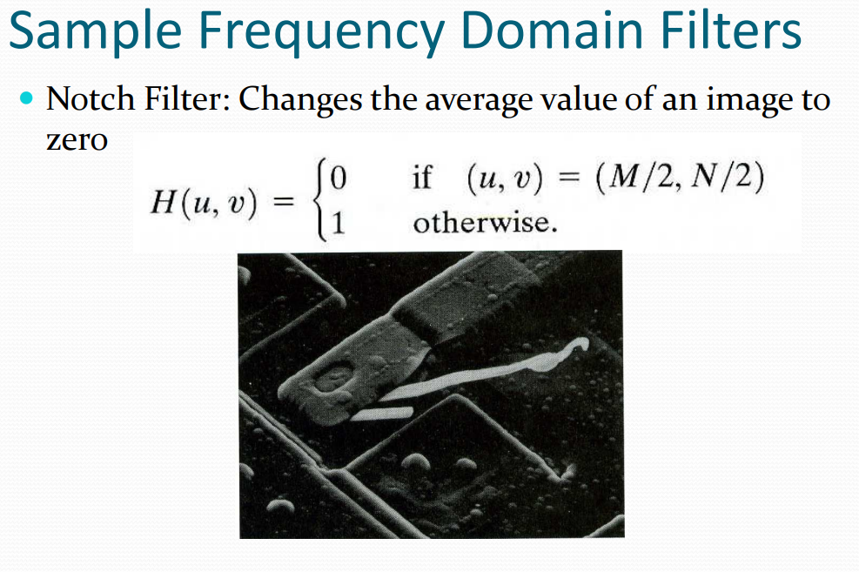

Slide 39
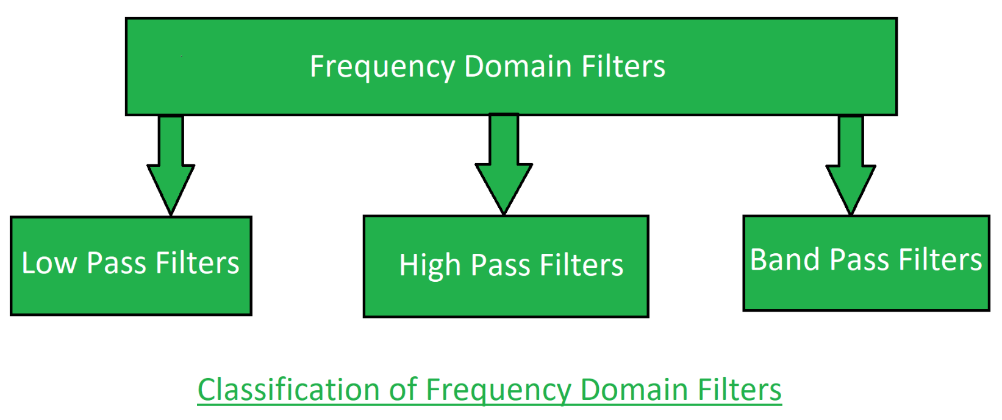

Slide 40
Low pass filter: Low pass filter removes the high frequency components that means it keeps low frequency components.
It is used for smoothing the image. It is used to smoothen the image by reduce high frequency components and preserving low frequency components. Mechanism of low pass filtering in frequency domain is given by:
G(u, v) = H(u, v) . F(u, v)where
F(u, v) is the Fourier Transform of original image H(u, v) is the Fourier Transform of filtering mask

Slide 41
High pass filter: High pass filter removes the low frequency components that means it keeps high frequency components.
It is used for sharpening the image. It is used to sharpen the image by attenuating low frequency components and preserving high frequency components. Mechanism of high pass filtering in frequency domain is given by:
H(u, v) = 1 - H'(u, v)where
H(u, v) is the Fourier Transform of high pass filtering
H'(u, v) is the Fourier Transform of low pass filtering

Slide 42
Band pass filter: Band pass filter removes the very low frequency and very high frequency components
that means it keeps the moderate range band of frequencies.
Band pass filtering is used to enhance edges while reducing the noise at the same time.

Slide 43
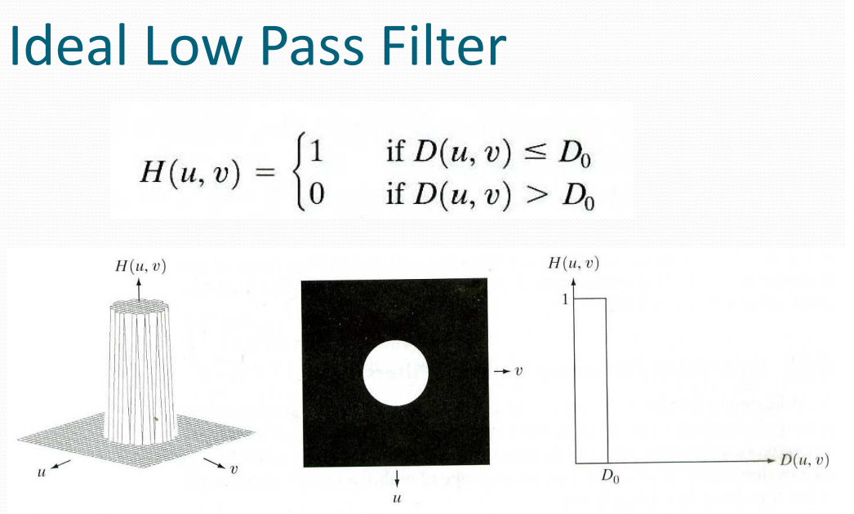
In this all frequencies within a circle of radius D0 from origin &
Cuts off all frequencies outside this circle is called ILPF.
D0 --> +ve constant
D(u,v)--> distance b/w a point (u,v) in frequency domain.

Slide 44
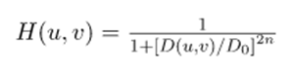
Butterworth Lowpass Filter (BLPF) is used for image smoothing in the frequency domain.
It removes high-frequency noise from a digital image and preserves low-frequency components. The transfer function of BLPF of order n is defined as-
Where,
D0 is a positive constant.
BLPF passes all the frequencies less than D{0} value without attenuation and cuts off all the frequencies greater than it.
This D_{0} is the transition point between H(u, v) = 1 and H(u, v) = 0, so this is termed as cutoff frequency.
But instead of making a sharp cut-off (like, Ideal Lowpass Filter (ILPF)), it introduces a smooth transition from 1 to 0 to reduce ringing artifacts.
D(u, v) is the Euclidean Distance from any point (u, v) to the origin of the frequency plane,

Slide 45
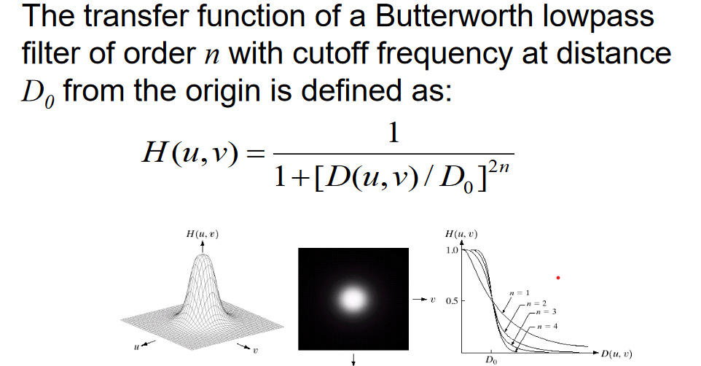

Slide 46
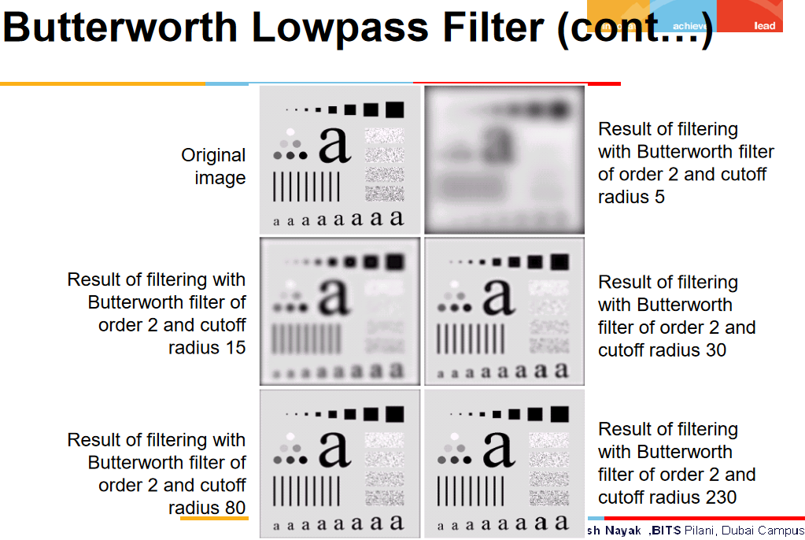

Slide 47
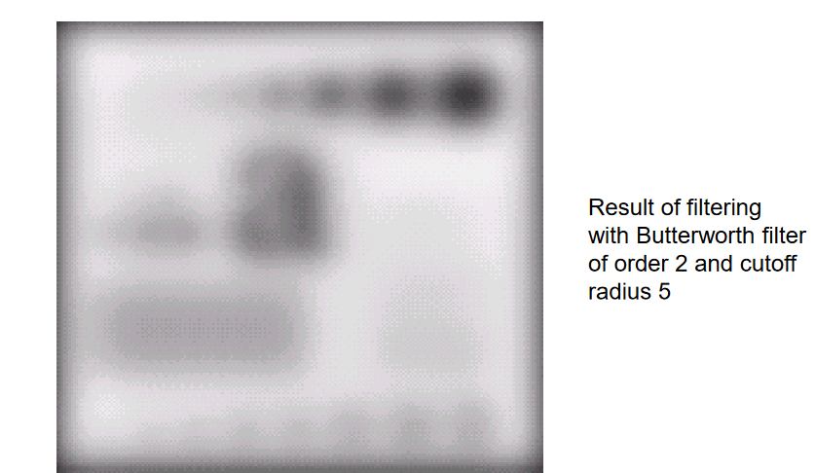

Slide 48
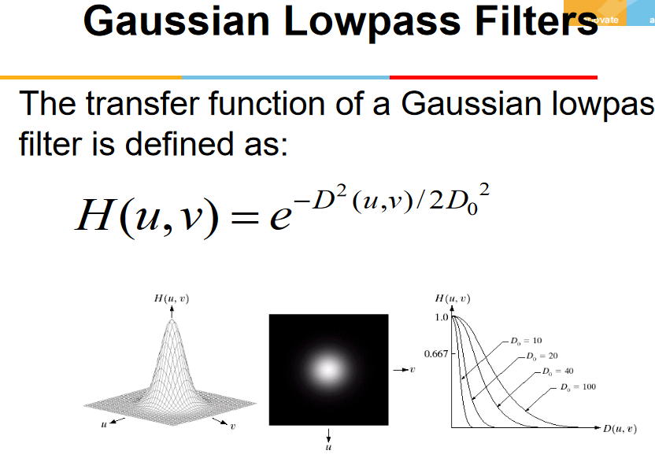

Slide 49
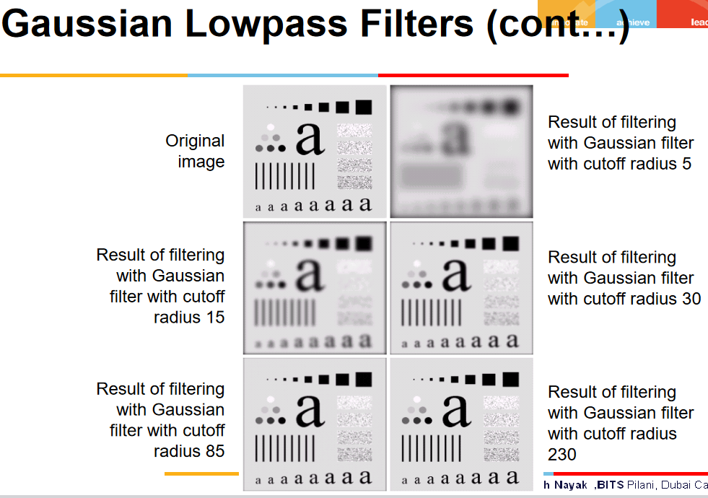

Slide 50
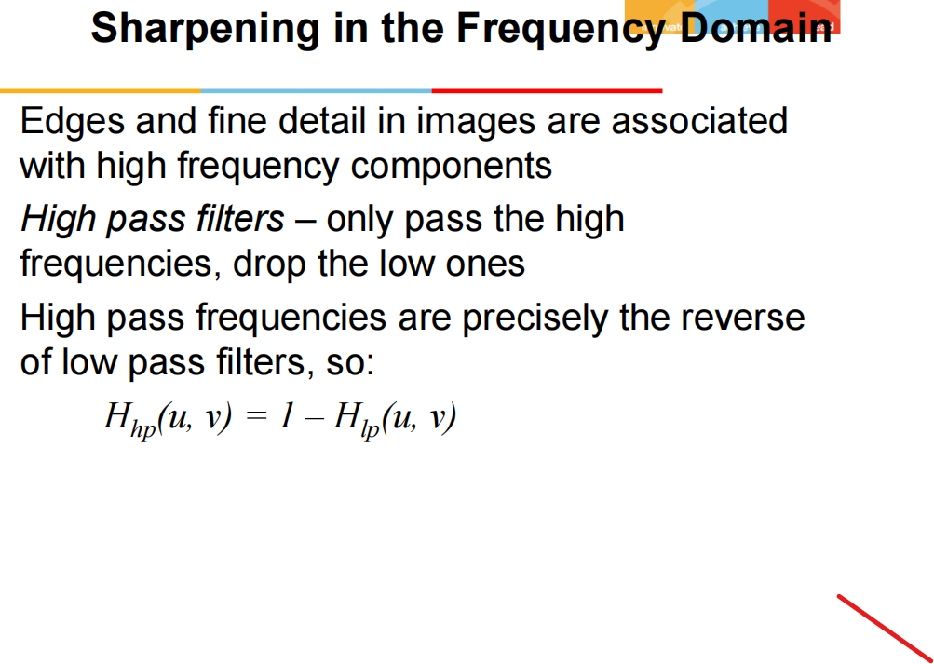

Slide 51
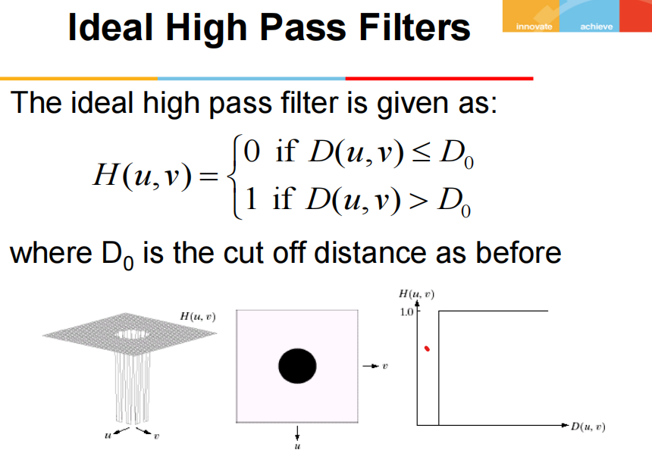

Slide 52
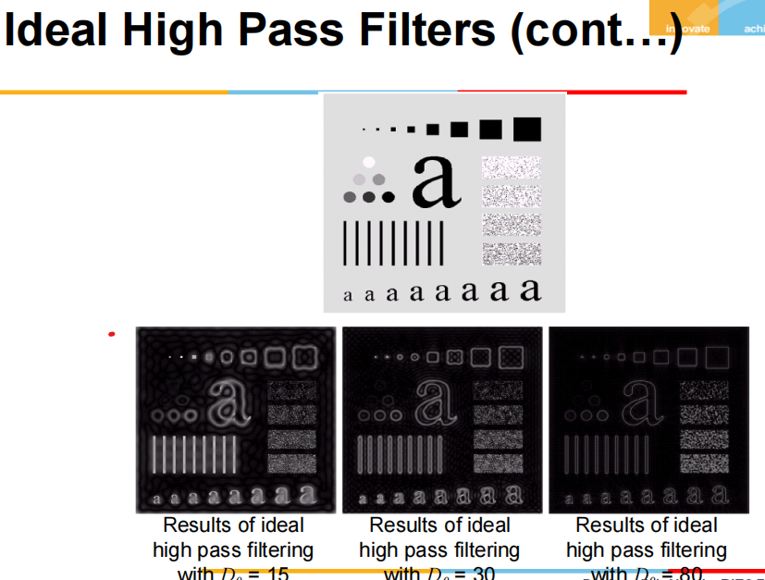

Slide 53
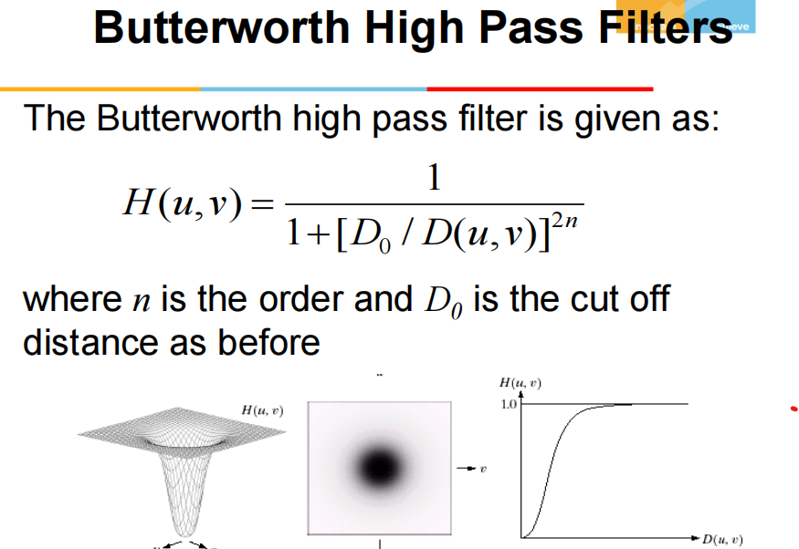

Slide 54
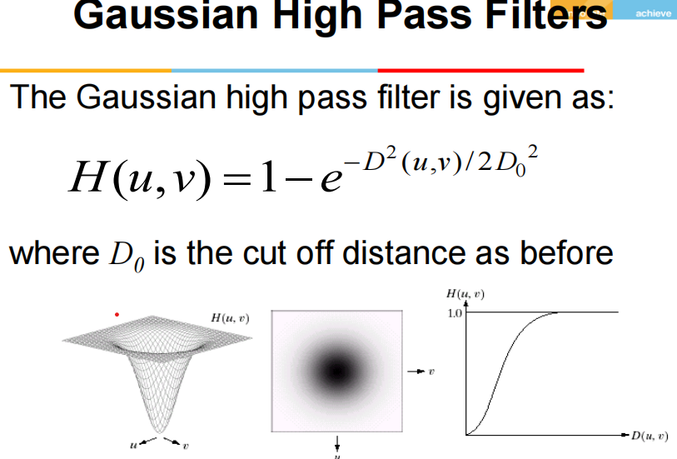

Slide 55
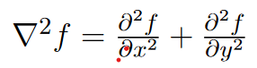
Using the Second derivative for Image Sharpening -The Laplacian in Spacial domain
To construct the filter mask based on 2-D, second order derivatives formulation.
Isotropic filters are applied; These are rotation invarient
Isotropic derivative operator is Laplacian,
which is a function f(x,y) of 2 variables

Slide 56
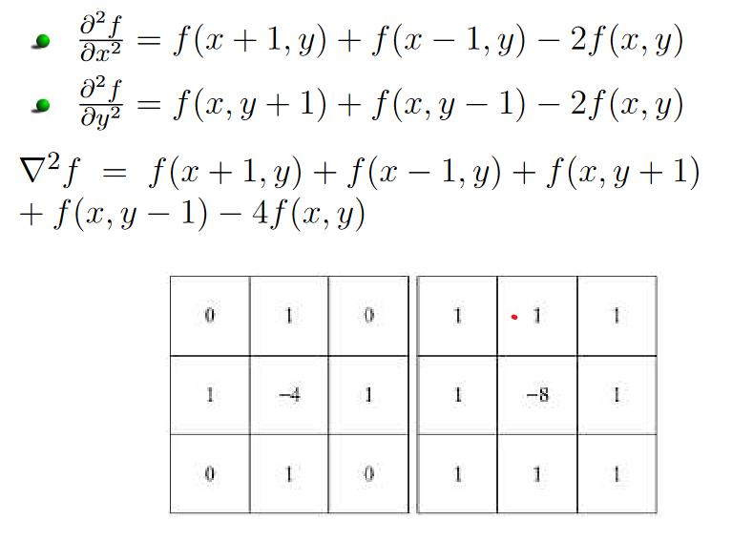
To express the equation in discrete form
In the x-direction, y-direction and both we have

Slide 57
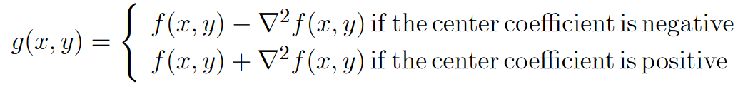
If the defination used has a -ve center coefficient, then we subtract, rather than add.
Laplacian image is to sharpened result.
Thus we use Laplacian for Image Sharpening is
g(x,y)= f(x,y) +c[∇² f(x,y)]
c=-1, if Laplacian filter rotates in 90⁰ & 45⁰
c=-1, for other cases.
^{i.e.,}

Slide 58
Laplacian in Frequency domain
H(u,v)= -4π²(u²+v²)
with respect to the center of the frequency rectangle,using the filter
If f (and F) are of size M X N,
this operation shifts the center transform so that (u, v) = (0, 0) is at point (M/2, N/2) in the frequency rectangle.
As before, the center of the filter function also needs to be shifted:
H(u,v)= -4π²[(u-M/2)²+(v-N/2)²] = -4π²D²(u,v)

Slide 59
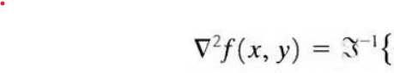
H(u,v)F(u,v)}
Enhanced image is :
g(x,y)= f(x,y) +c[∇² f(x,y)]
f(x,y) is [-1,1]

Slide 60
Unsharp Masking and Highboost filtering
Printing & publishing industry sharpens the images-
which consists of subtracting an unsharp (smoothed) version of image from original image.
this process is called unsharp masking.
It has following steps:
Blur the original image. f _{b}(x,y)
Subtract the blurred image from original (mask)
Add the mask to the original.

Slide 61
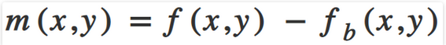

Thus, unsharp masking first produces a mask m(x,y) as
where, f(x,y) is the original image and fb(x,y) is the blurred version of the original image.
Then this mask is added back to the original image which results in enhancing the high-frequency components.

Slide 62
Unsharp Masking and Highboost filtering in Frequency domain
Thus, unsharp masking first produces a mask m(x,y) as
fb(x,y) = F⁻¹ [H_{LP} (u,v)F(u,v)]
where, f(x,y) is the original image and fb(x,y) is the blurred version of the original image.
Then this mask is added back to the original image which results in enhancing the high-frequency components.

Slide 63
Homomorphic Filtering in Frequency domain
Homomorphic filtering can be used for improving the appearance of a grayscale image by simultaneous intensity range compression (illumination) and contrast enhancement (reflection).
m ( x , y ) = i ( x , y ) ∙ r ( x , y ) Where,
m = image,
i = illumination,
r = reflectance

Slide 64
We have to transform the equation into frequency domain in order to apply high pass filter. However, it's very difficult to do calculation after applying Fourier transformation to this equation because it's not a product equation anymore. Therefore, we use 'log' to help solve this problem.
ln ( m ( x , y ) ) = ln ( i ( x , y ) ) + ln ( r ( x , y ) )
Then, applying Fourier transformation
ϝ ( l n ( m ( x , y ) ) ) = ϝ ( l n ( i ( x , y ) ) ) + ϝ ( l n ( r ( x , y ) ) )
Or M ( u , v ) = I ( u , v ) + R ( u , v )

Slide 65


